Slide 1
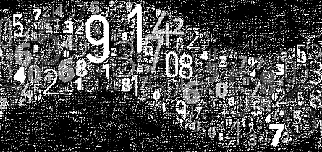
Random Number/Variate Generation
Mohammad Ramshani
University of Tennessee

Slide 2
What to Expect
We go over
Practical techniques to generate random variables
From both standard and non-standard distributions

Slide 3
Random Numbers
Why is random number generation necessary?
In a simulated system, there are inherently random components that require a method of obtaining numbers that are random.
For example - a queuing system model requires interarrival times, service times, etc., that were drawn from some specified distribution.

Slide 4
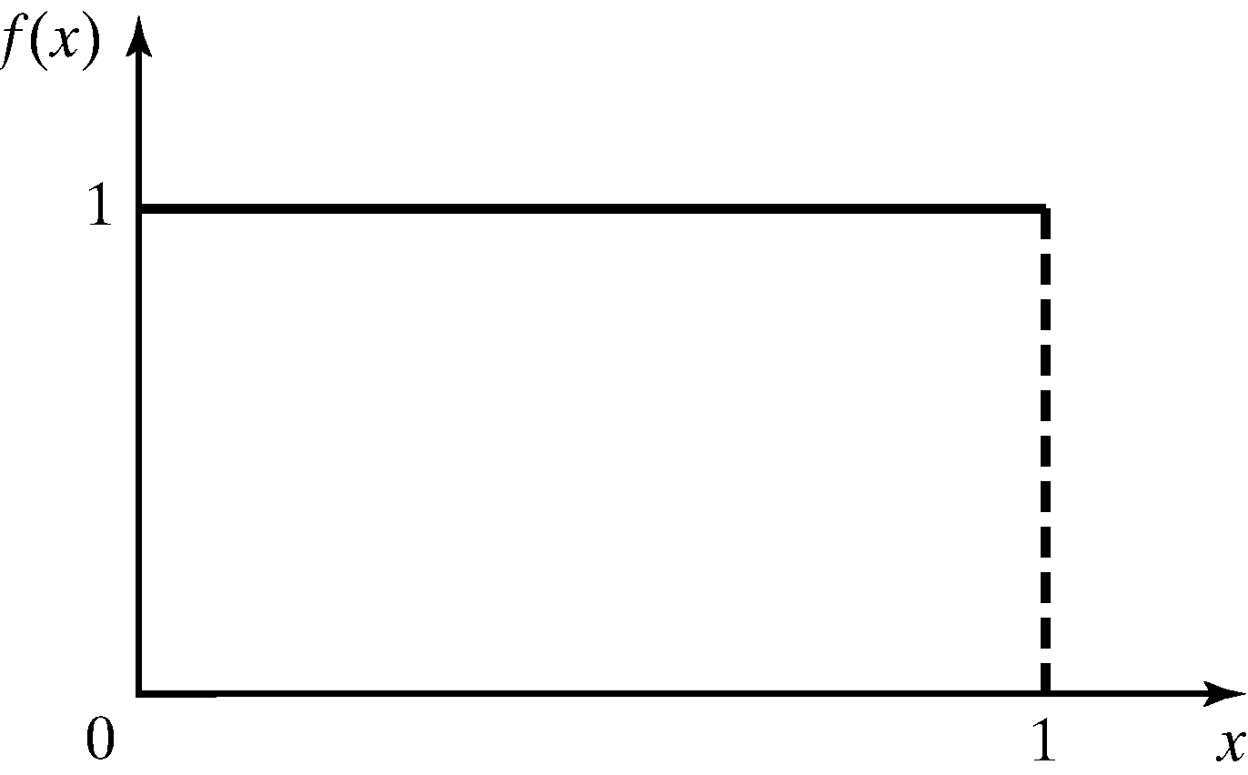
Properties of Random Numbers
Two important statistical properties:
Uniformity (they are equally probable every where)
Independence (The current value of a random variable has no relation with the previous values)
Random Number, R_{i}, must be independently drawn from a uniform distribution with pdf:
Figure: pdf for random numbers

Slide 5
Properties of Random Numbers
Expected value and variance of random numbers
Expected value of each R_{i} is given by
Variance for each R_{i} is given by

Slide 6
Generation of Pseudo-Random Numbers
“Pseudo”, because generating numbers using a known method removes the potential for true randomness.
Goal: To produce a sequence of numbers in [0,1] that simulates, or imitates, the ideal properties of random numbers (RN).
Important considerations in RN routines:
Fast
Portable to different computers
Have sufficiently long cycle
Replicable
Closely approximate the ideal statistical properties of uniformity and independence.
Notes:
The issue is, we are using a known method to generate these random values. So they are not truly random!

Slide 7
Random Number Generators
Mid-square Generator
Random number seed
Initial random number used to generate the next random number which is in turn transformed into the new seed value.
Proposed by von Neumann and Metropolis in the 1940’s
Start with an initial four-digit positive integer seed X₀
Square it to obtain an integer with up to eight digits
Take the middle four digits as the next four-digit number, X₁
Place a decimal point at the left of X₁ to get first random number R₁
Square X₁ and continue process

Slide 8
Mid-square Generator
Let X₀ = 5497
X₁ = (5497)² = 30217009 X₁ = 2170, R₁ = 0.2170
X₂ = (2170)² = 04708900 X₂ = 7089, R₂ = 0.7089
X₃ = (7089)² = 50253921 X₃ = 2539, R₃ = 0.2539
...and so on...
Pros of the mid-square method
Rather simple to implement
Cons of the mid-square method
Difficult to choose initial seed that will give good sequence
Strong tendency to degenerate fairly rapidly to zero

Slide 9
Mid-square Generator
Difficult to choose initial seed that will give good sequence
Strong tendency to degenerate fairly rapidly to zero
Let X₀ = 5197
X₁ = (5197)² = 27008809 X₁ = 0088, R₁ = 0.0088
X₂ = (0088)² = 00007744 X₂ = 0077, R₂ = 0.0077
X₃ = (0077)² = 00005929 X₃ = 0059, R₃ = 0.0059
X₄ = (0059)² = 00003481 X₄ = 0034, R₄ = 0.0034
Seed = | 2784
1 | 7750656 | 7506
2 | 56340036 | 3400
3 | 11560000 | 5600
4 | 31360000 | 3600
5 | 12960000 | 9600
6 | 92160000 | 1600
7 | 2560000 | 5600
8 | 31360000 | 3600
9 | 12960000 | 9600
10 | 92160000 | 1600
11 | 2560000 | 5600

Slide 10
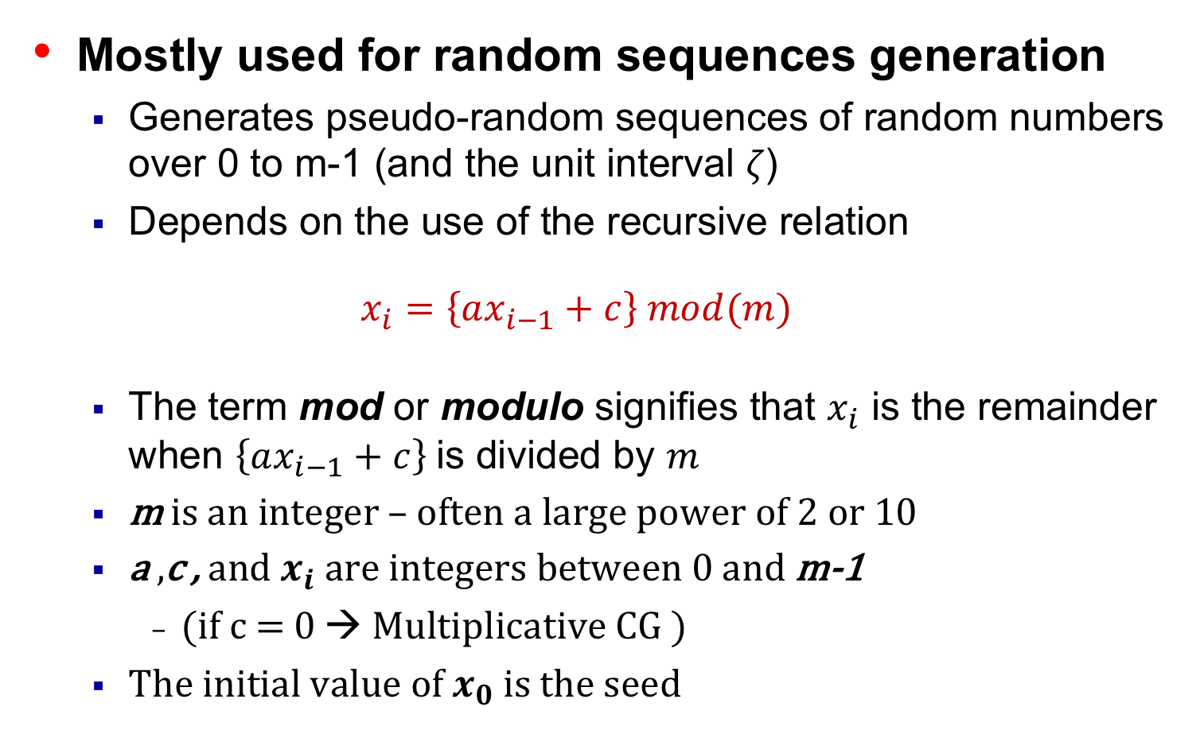
Linear (Multiplicative) Congruential Generator
Mostly used for random sequences generation
Generates pseudo-random sequences of random numbers over 0 to m-1 (and the unit interval 𝜁)
Depends on the use of the recursive relation
$$x_{i}=\left\{ax_{i−1}+c\right\} mod(m)$$
The term mod or modulo signifies that $x_{i}$ is the remainder when $\left\{ax_{i−1}+c\right\}$is divided by $m$
m is an integer – often a large power of 2 or 10
a ,c , and $x_{i}$ are integers between 0 and m-1
(if c = 0 → Multiplicative CG )
The initial value of $x_{0}$ is the seed
Notes:
This gives us a pseudo random number again! Remember they are methods to generate random numbers so they are pseudo random
The value of m is always taken as the largest number that can be generated on a computer (depends on the bits capacity of the processor: 2^n for n bits capacity of a processor) Speed and efficiency are aided by a modulus, m, to be (or close to) a power of 2 as most computers use a binary representation to store values
LCGs are slower than MCGs and MCGs are more frequently used
So while we generate sequence of numbers over 0 to m-1, we actually divide them by m and generate numbers over the unit interval and show them by zeta

Slide 11

Linear (Multiplicative) Congruential Generator
Use $x_{0}$ = 27, a = 17, c = 43, and m = 100.
The $x_{i}$ and $ζ_{i}$values are:
X₁ = (17*27+43) mod 100 = 502 mod 100 = 2, $ζ$₁ = 0.02;
X₂ = (17*2+43) mod 100 = 77, $ζ$₂ = 0.77;
X₃ = (17*77+43) mod 100 = 52, $ζ$₃ = 0.52;
…

Slide 12
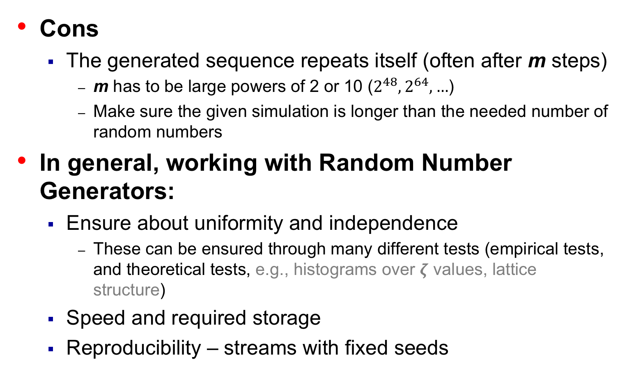
Linear (Multiplicative) Congruential Generator
Cons
The generated sequence repeats itself (often after m steps)
m has to be large powers of 2 or 10 ($2^{48}, 2^{64},…$)
Make sure the given simulation is longer than the needed number of random numbers
In general, working with Random Number Generators:
Ensure about uniformity and independence
These can be ensured through many different tests (empirical tests, and theoretical tests, e.g., histograms over $ζ$ values, lattice structure)
Speed and required storage
Reproducibility – streams with fixed seeds
Notes:
Streams are long internal subsequences

Slide 13

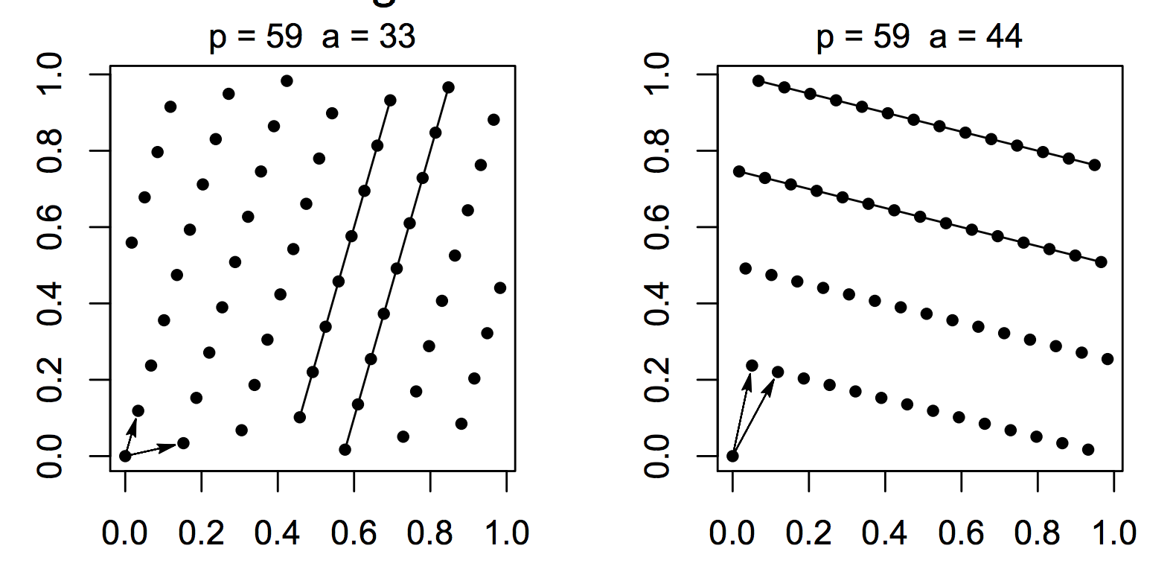
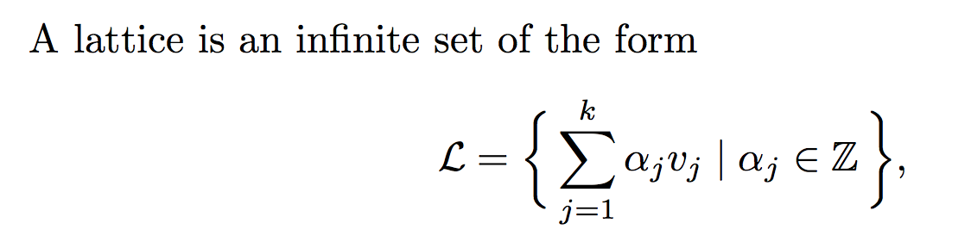

Lattice Structure
Two MCGs
m = 59, a = 33 and a = 44
Plotted for ${(ζ}_{i},ζ_{i+1})$ for $1≤i≤P$

Slide 14
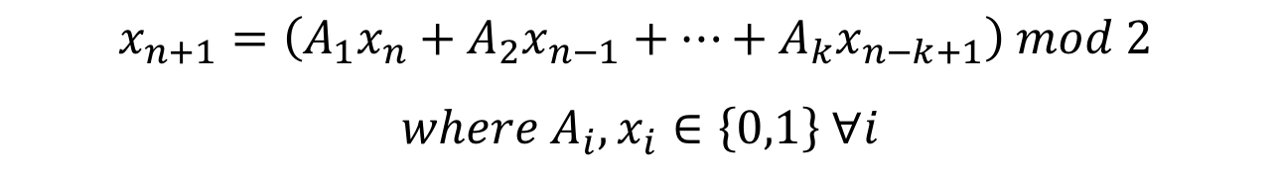
More RNGs
Quadratic Congruential Generator
X_{new} = (a₁ * X_{old}² + a₂ * X_{old} + c) mod m
Combination of generators
Shuffling – shuffle the output from the first LCG with a second LCG
L’Ecuyer – takes integers generated from two different LCGs with different moduli
Wichman/Hill – takes the fractional parts of multiple random numbers generated from separate generators
Tausworthe generator
Multiplicative recursive generator
$$x_{n+1}=\left(A_{1}x_{n}+A_{2}x_{n−1}+…+A_{k}x_{n−k+1}\right) mod 2$$
$$where A_{i},x_{i}∈\left\{0,1\right\} ∀i$$

Slide 15
Characteristics of a Good Generator
Maximum Density
Such that he values assumed by R_{i}, i = 1,2,…, leave no large gaps on [0,1]
Question: R_{i} values are discrete, how can we increase the density?
Solution: a very large integer for modulus m
Approximation appears to be of little consequence
Maximum Period
To achieve maximum density and avoid cycling.
Achieve by: proper choice of a, c, m, and X₀.
Most digital computers use a binary representation of numbers
Speed and efficiency are aided by a modulus, m, to be (or close to) a power of 2.

Slide 16
Random-Variate Generation
Purpose
Develop understanding of generating samples from a specific distribution as input to a simulation model.
Illustrate some widely-used techniques for generating random variates.
Inverse-transform technique
Acceptance-rejection technique

Slide 17
Inverse-transform Technique
The concept:
For cdf: r = F(x)
Generate r from uniform (0,1)
Find x:
r = F(x)
r₁
x = F⁻¹(r)
x₁
Notes:
Useful to generate random variates from the exponential, the uniform, the Weibull and the triangle distributions.
The basic principle is to find the inverse of function F

Slide 18
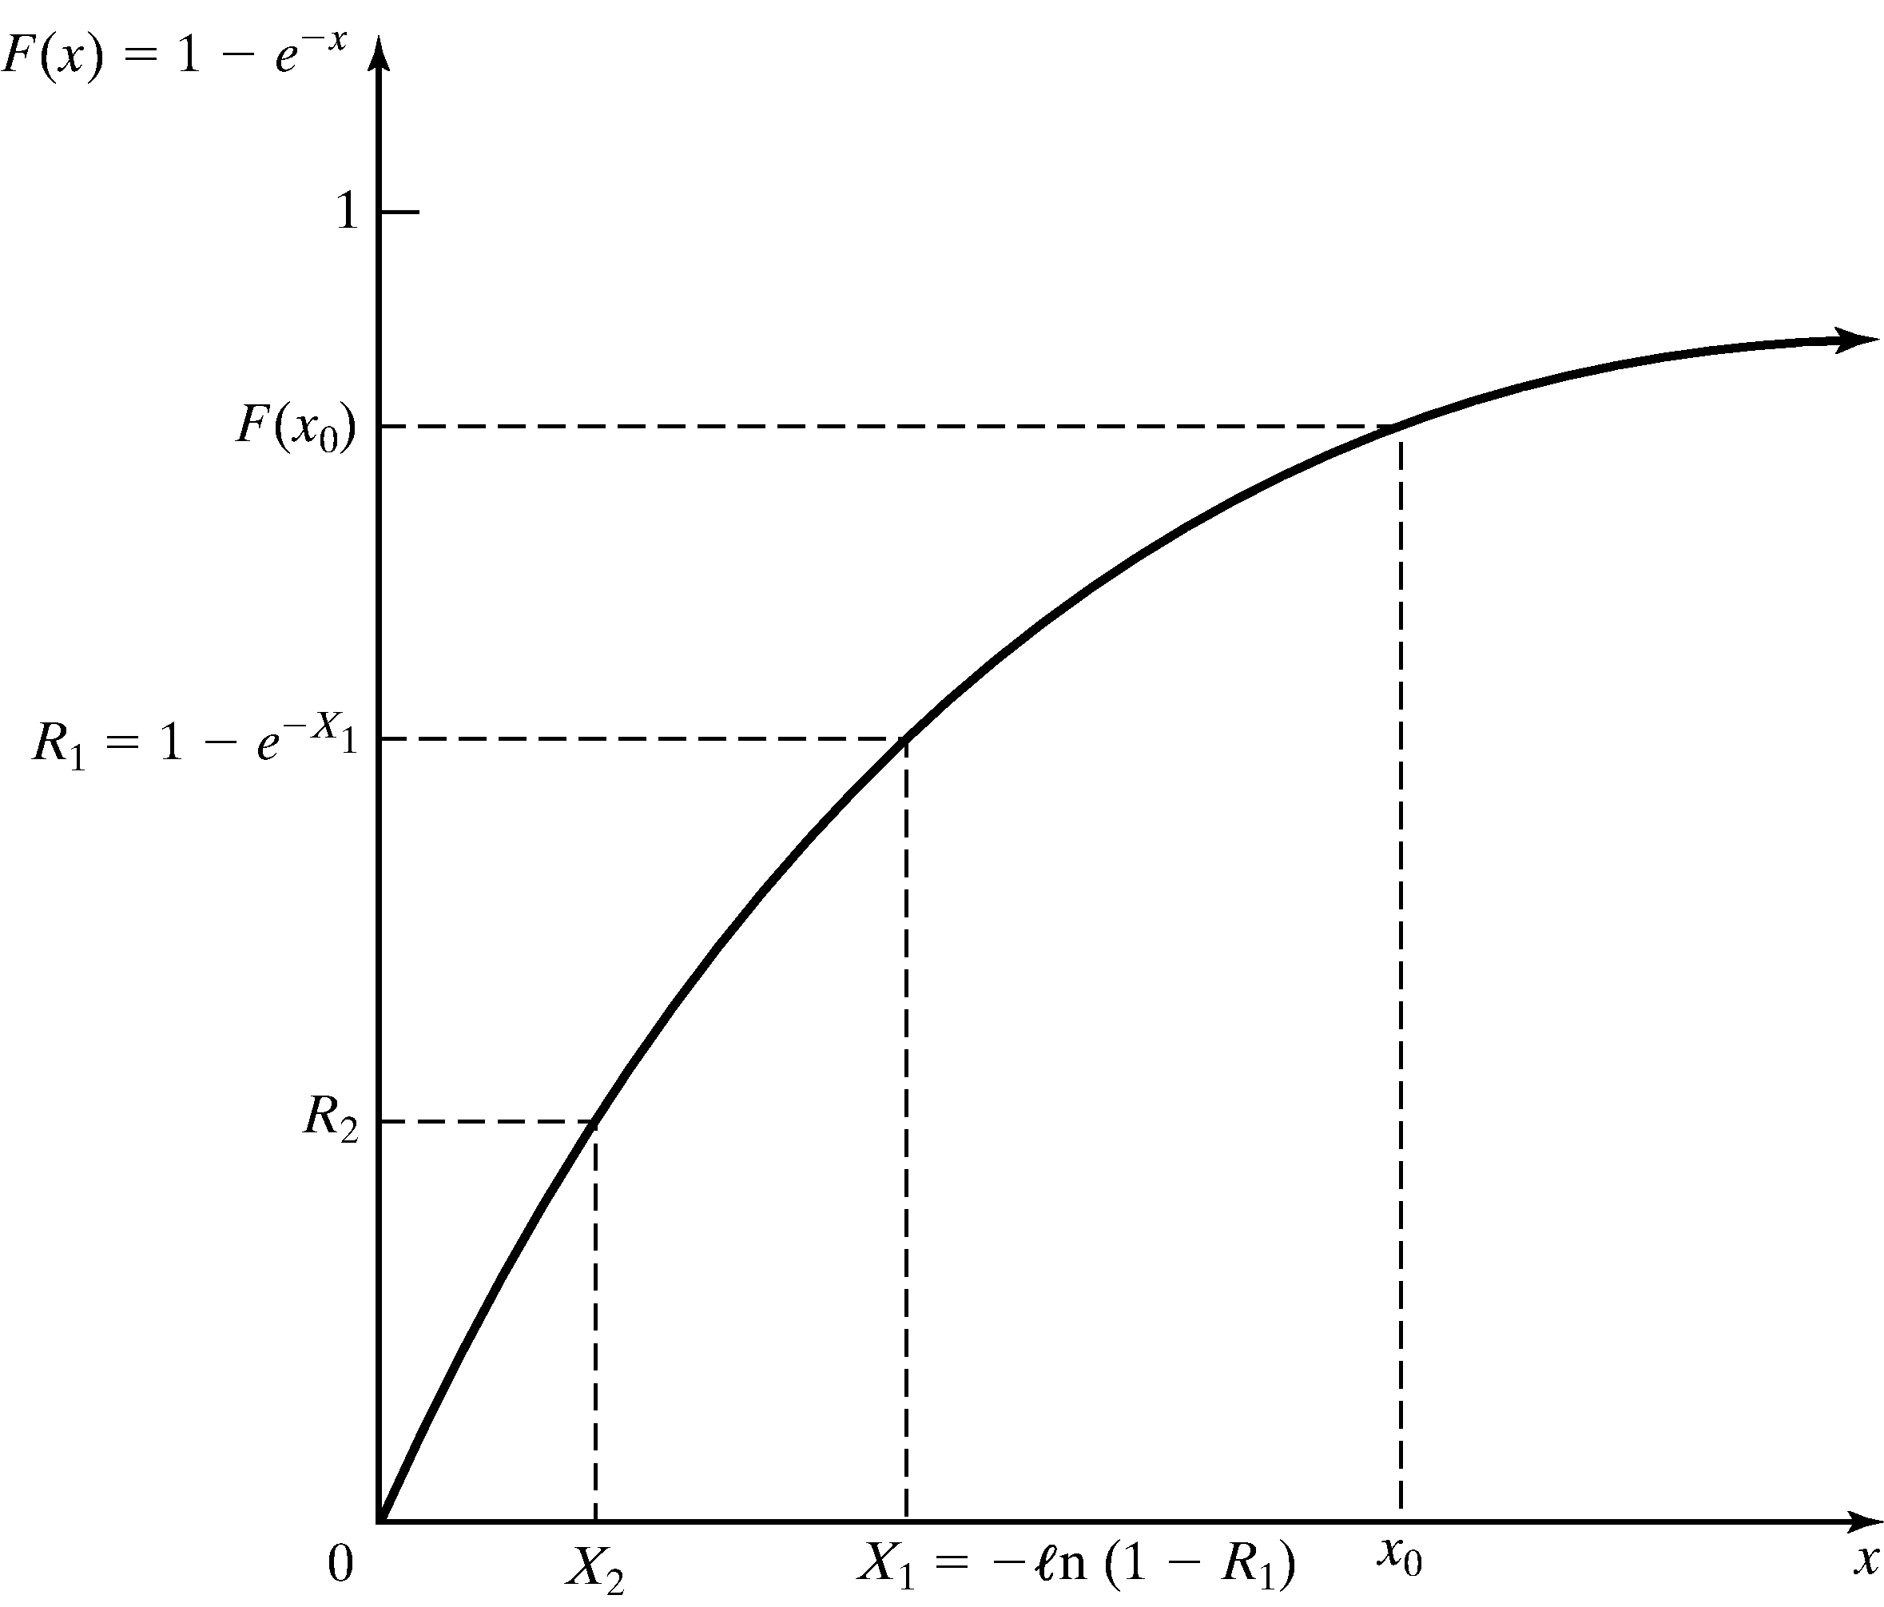
Exponential Distribution
Exponential Distribution:
Exponential cdf:
To generate X₁, X₂, X₃ …
r = F(x)
= 1 – e^{-λx} for x ≥ 0
X_{i} = F⁻¹(R_{i})
= -(1/λ) ln(1-R_{i})
Figure: Inverse-transform technique for exp(λ = 1)
Notes:
Generate random numbers R_i where there range between (0,1) and calculate the random variate based on the generated R_i value.

Slide 19
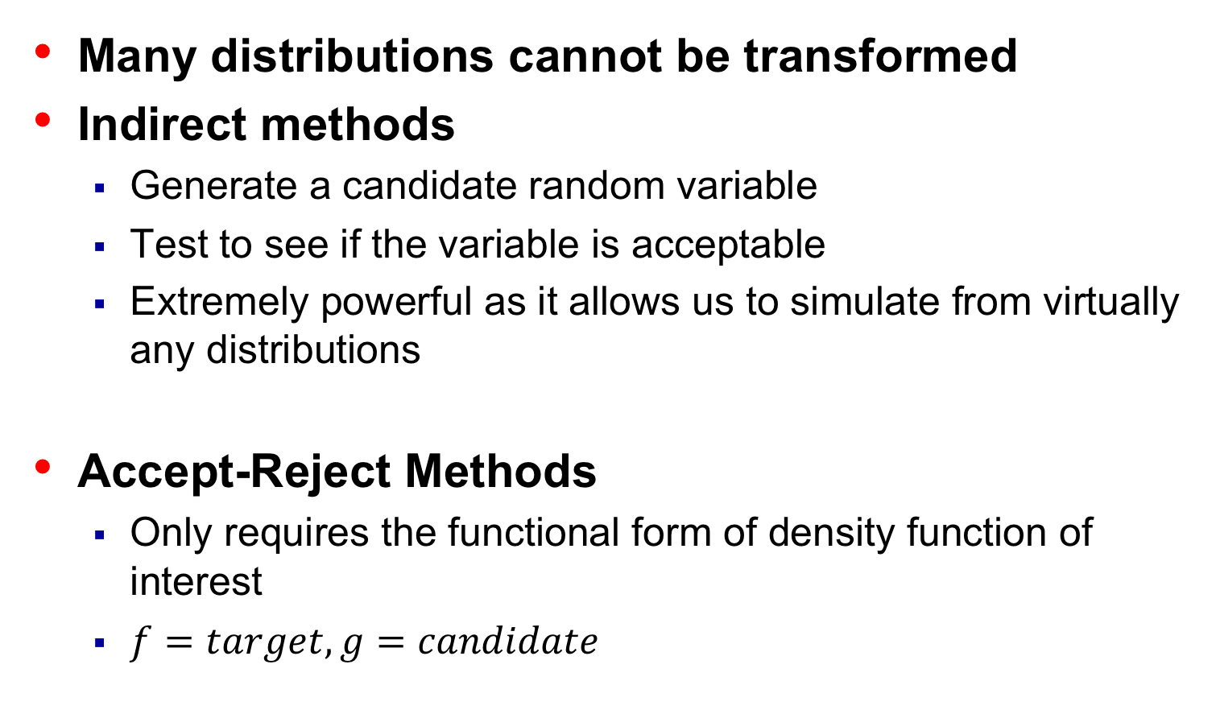
Acceptance-Rejection Technique
Many distributions cannot be transformed
Indirect methods
Generate a candidate random variable
Test to see if the variable is acceptable
Extremely powerful as it allows us to simulate from virtually any distributions
Accept-Reject Methods
Only requires the functional form of density function of interest
$f=target, g=candidate$
Notes:
The basic idea is to find an alternative probability distribution G, with density function g(x), from which we already have an efficient algorithm for generating from
such that the function g(x) is “close” to f(x)
we assume that the ratio f(x)/g(x) is bounded by a constant c > 0; supx{f(x)/g(x)} ≤ c. (And in practice we would want c as close to 1 as possible.)
Normal and beta distributions

